Slide 1
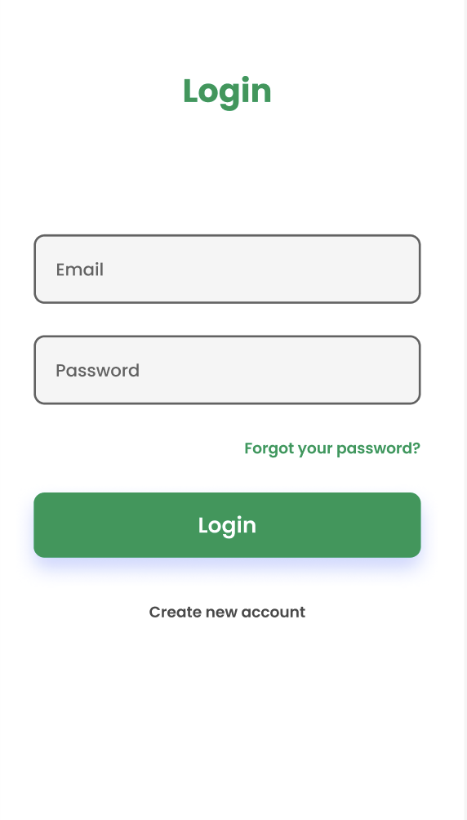
Grocery Lister App CS495: Final Project
Designed by: Bushra, Mariyam, & Tushar
Notes:
Tushar opens - introduces self & overall project

Slide 2
Roadmap
01.
02.
03.
04.
05.
06.
Empathize
Define
Ideate
LoFi Prototype
MedFi Prototype
HiFi Prototype
Notes:
Tushar explains roadmap

Slide 3
Empathize
Interviewee 1
Interviewee 2
Female, 20, Student: Inexperienced shopper
Male, 50, Employed: Organized & experienced shopper
Interviewee 3
Interviewee 4
Male, 38, Employed: Relatively experienced shopper
Male, 86 , Retired: Self dependent and highly experienced
Notes:
Bushra discusses who we interviewed

Slide 4
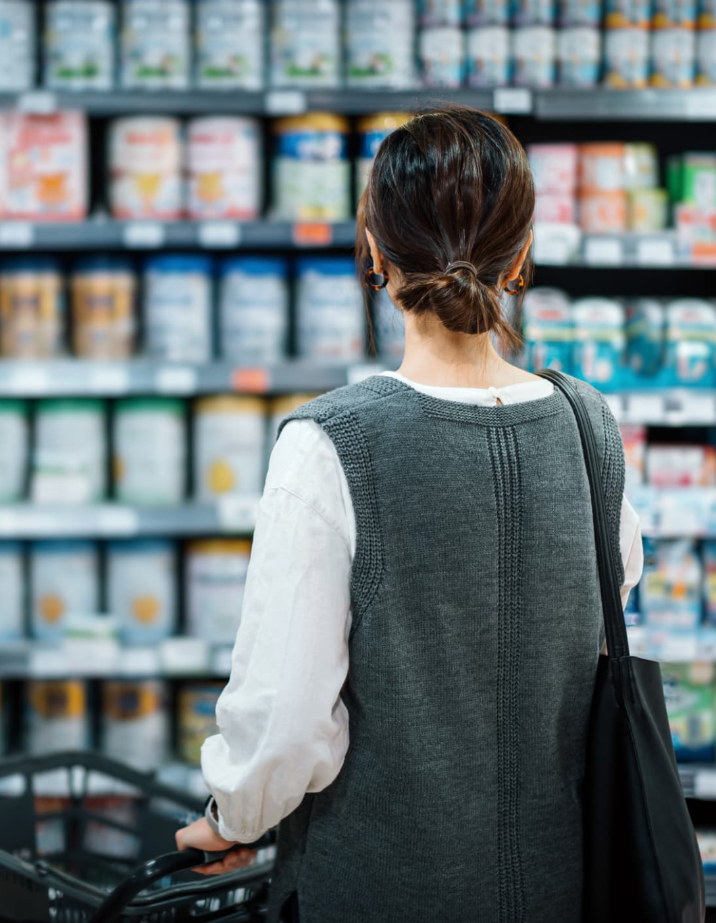
Empathize
We conducted 4 total interviews. We learned:
Motive: Grocery shopping = relaxing
Impulse: Buying unnecessary items
Budget: People go over-budget often
Notes:
Bushra discusses what we learned (most relevant to final product)

Slide 5
Define
Technology
Overspending
Gamification
How might we use technology to facilitate grocery list creation?
How might we prevent shoppers from overspending on non-essential items?
How might we use gamification to make grocery shopping more engaging?
Notes:
Mariyam defines some of our ideas using HMWs

Slide 6
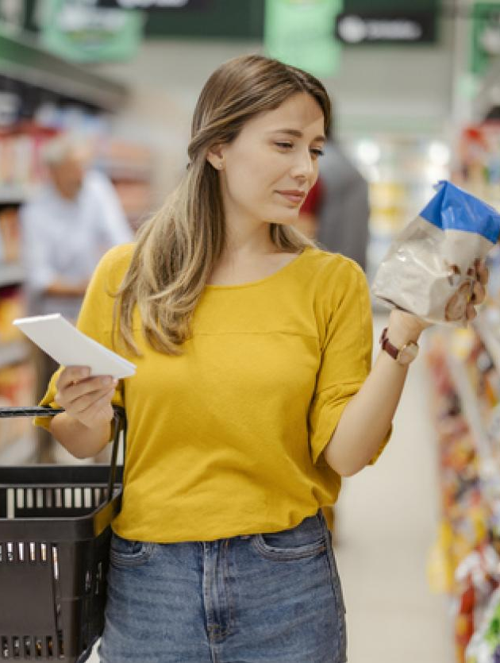
Define
We narrowed down 3 POVs. We decided:
Notify: People forget a lot - we need reminders
Predictable: Make it easy, expectable, replicable
Encouraging: Organization is key + motivation
Notes:
Mariyam discusses our takeaways to define the problem/concept that we’re going to tackle

Slide 7
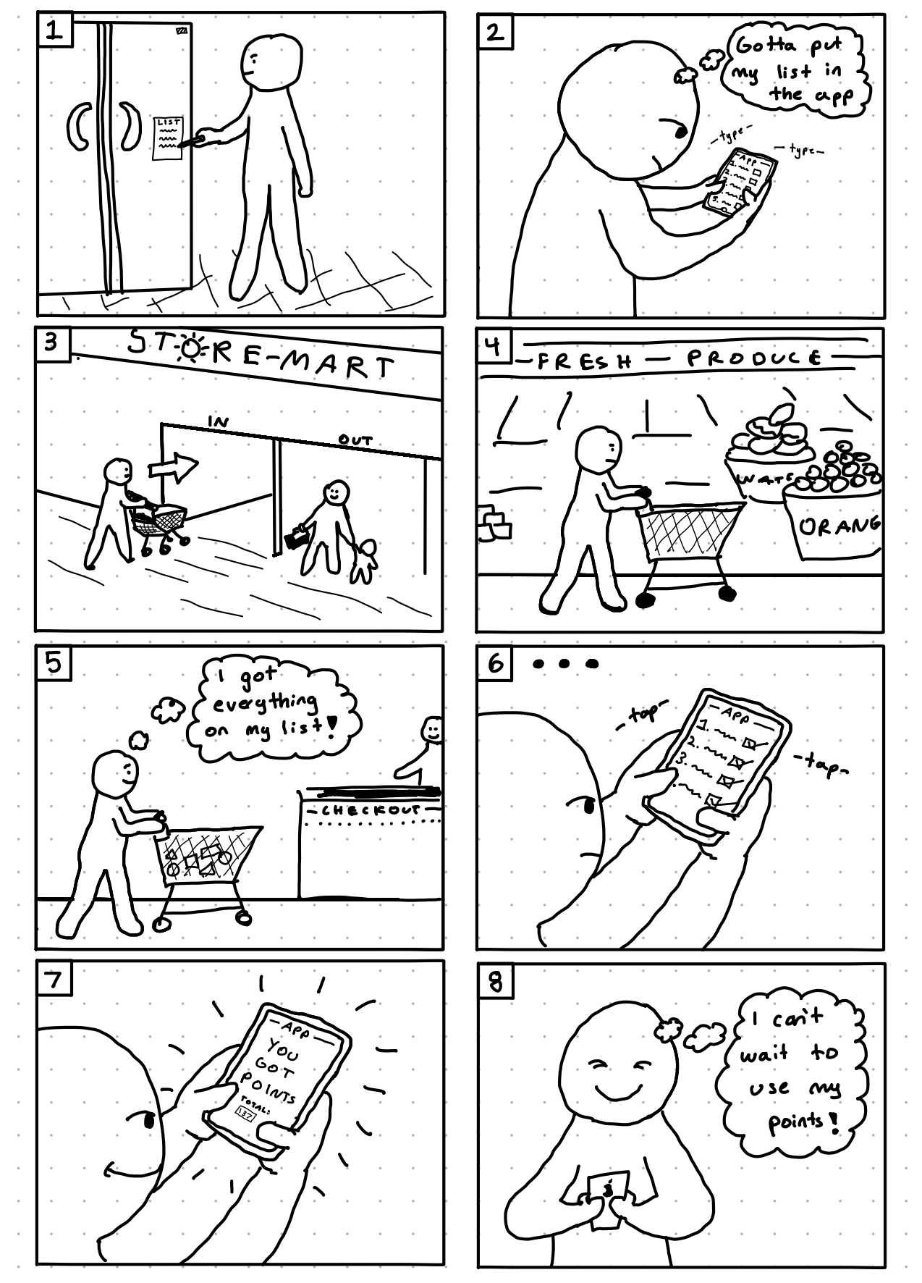
Ideate
We compared ideas and decided on:
Product: A grocery-listing mobile application
Features: Purchase history & list generation
Omit: Social & AI aspects - not enough time
Notes:
Bushra explains our ideas and what we landed on

Slide 8
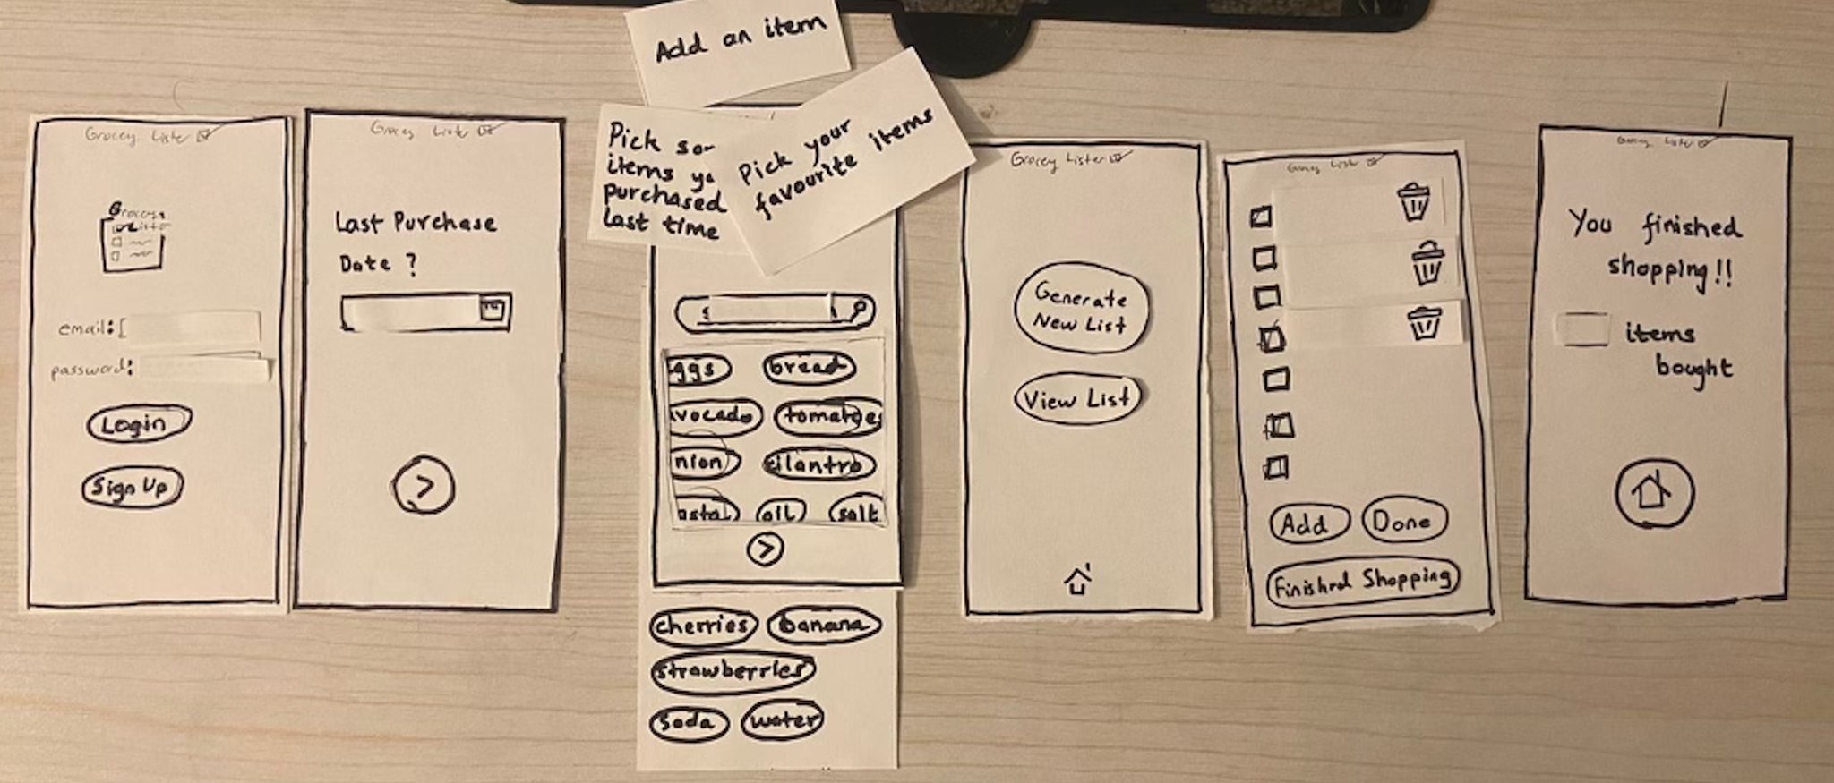
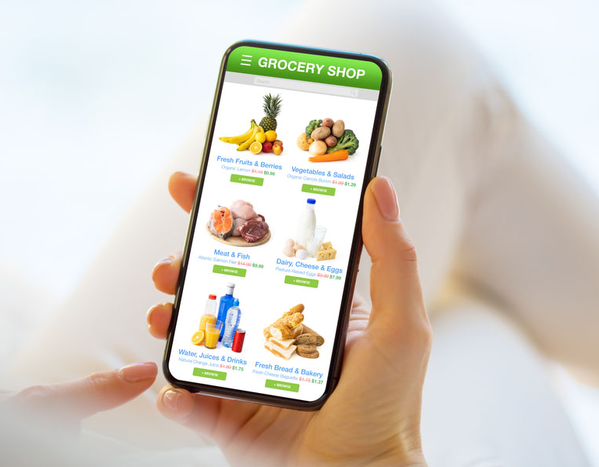
LoFi
What we learned at this stage:
Experience Prototype: Overall positive feedback - people would (theoretically) use the app
Paper Prototype: Identified issues - confusion with buttons & search bar - app features
Notes:
Tushar discusses experience prototype, Bushra discusses paper

Slide 9
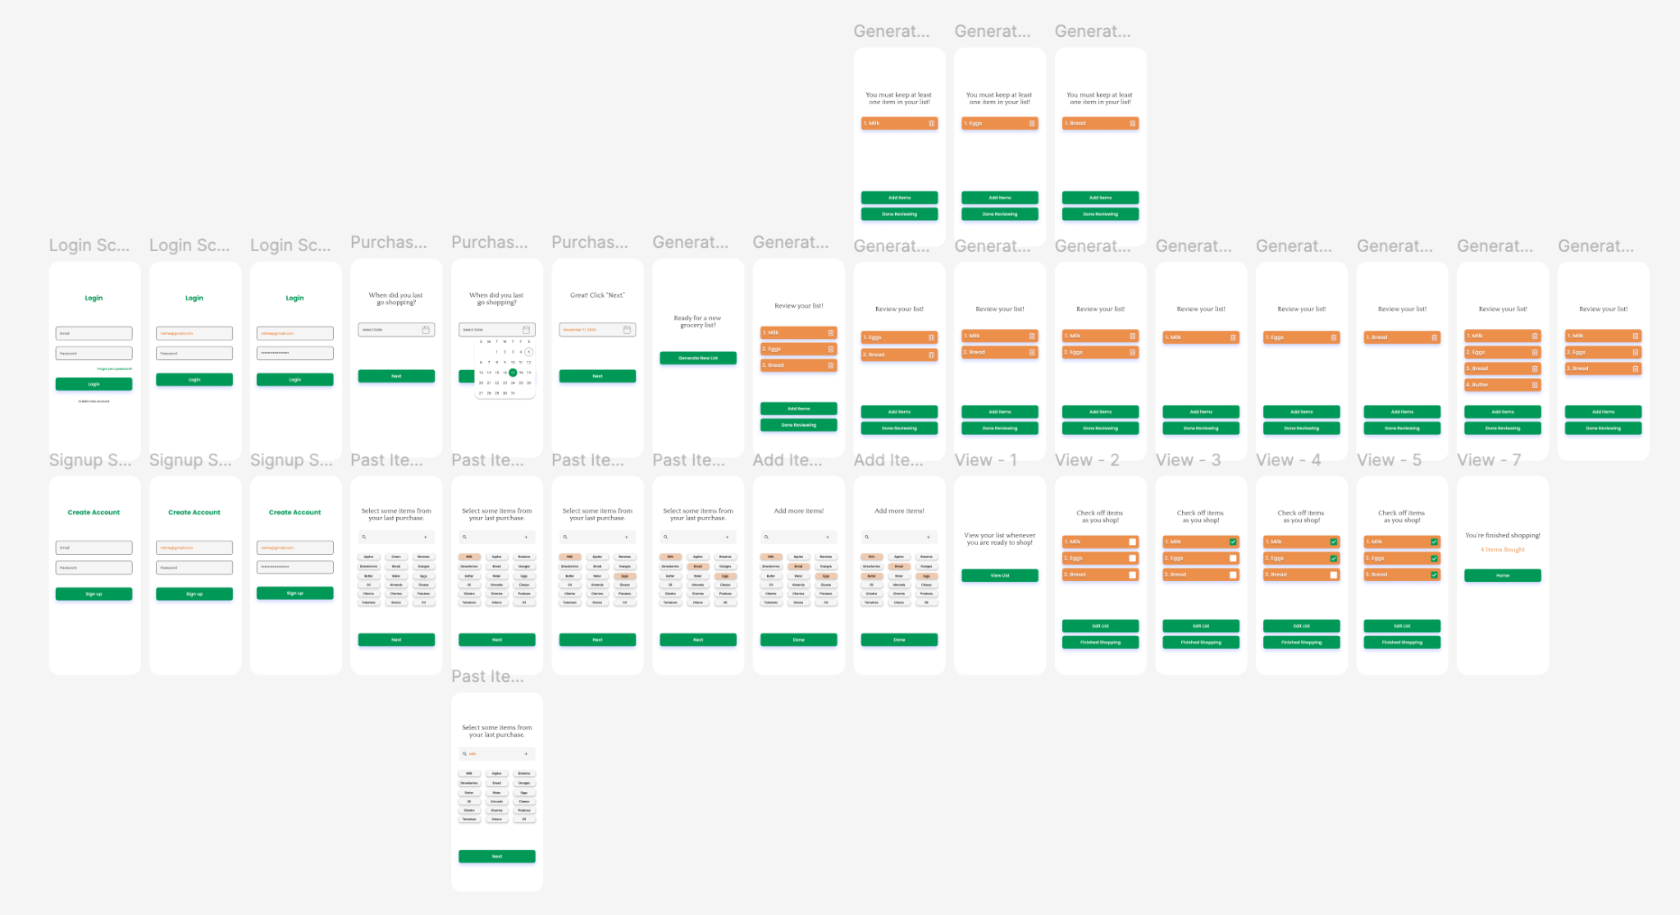
MedFi - Figma
Notes:
Mariyam introduces Figma and general overview of our screens

Slide 10
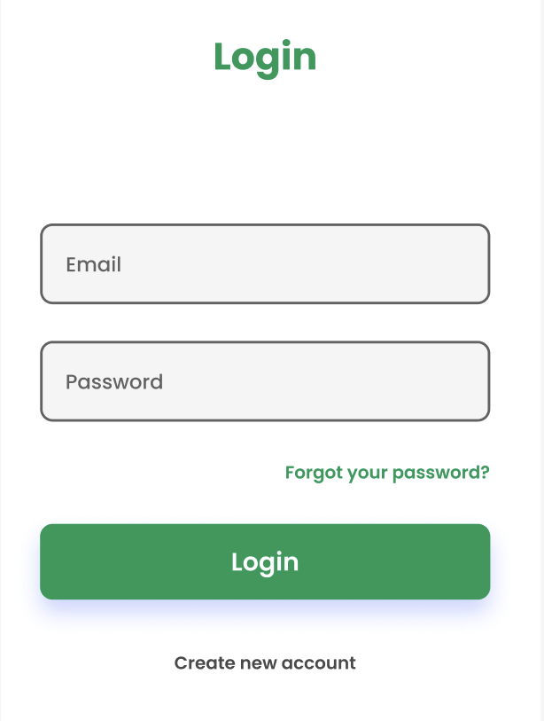
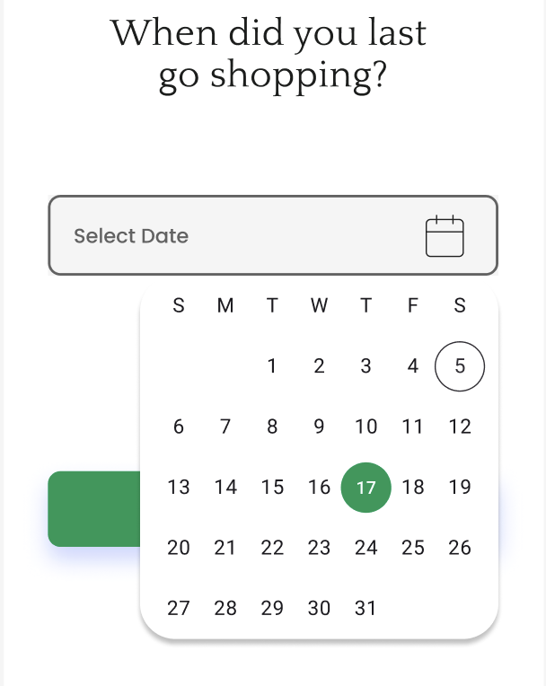
MedFi
Using Figma, we decided:
Colors: White, Green & Orange
Simple: Easy on the eyes
Intuitive: Anyone who has used an app before can use our app
Notes:
Bushra explains what we decided on for the app

Slide 11

HiFi
Notes:
Mariyam explains code stuff (JavaScript, React Native, Firebase) - Tushar explains database
*Exponential decay value used in list generation algorithm

Slide 12
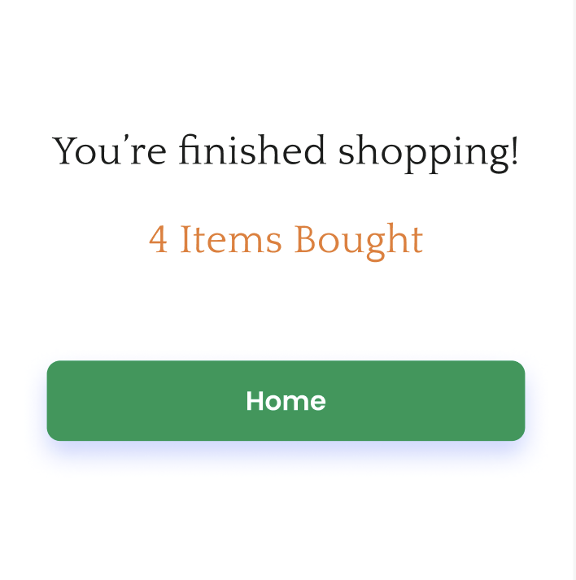
Thank You!
Questions?
This slide is for attribution - some images are from Google Images.
Notes:
Mariyam closes - Tushar opens floor for questions - all 3 answer as needed (whoever feels comfortable or knows the answer) - total time talking 4-5 min, questions 2-3 minutes

